Slide 1
技术写作
Technical Writing Practice
Based on Zhouquan’s PPT; Credits to Mr. Zhou

Slide 2
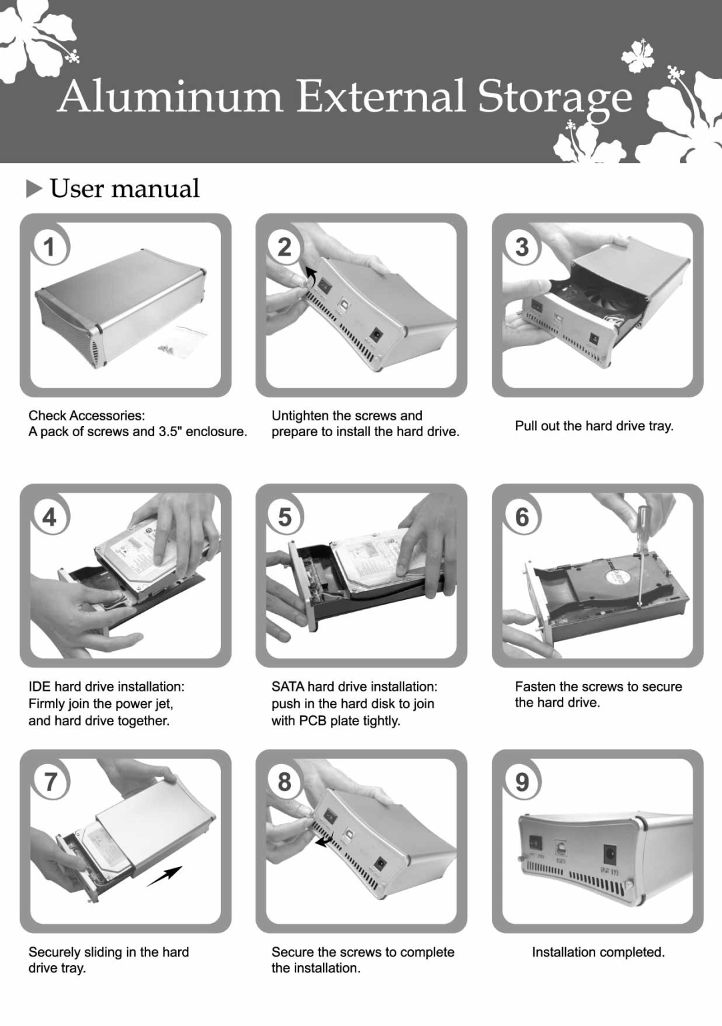
How to write a manual in your mind?

Slide 3
The process of writing instructions
Analyze your audience and purpose
State your purpose
Gather and organize your information
Design the document
Draft the document
Revise, edit, and proofread the document
Test the document

Slide 4
Why should we analyze audience and purposes?
https://mp.weixin.qq.com/s?__biz=MjM5MzM4NTUyOA==&mid=2686890968&idx=2&sn=335d9e0f6029c46259bd11e343713f01&chksm=8345ce8fb4324799d394e8ba76a453b164beb83b72716a0c9ca3f377bd9fb950d9121eab9b49&mpshare=1&scene=23&srcid=0831kaQgZPTVRGubAqTqLF85#rd
Practice: to sketch the skeleton of a bicycle as detailed as you can

Slide 5
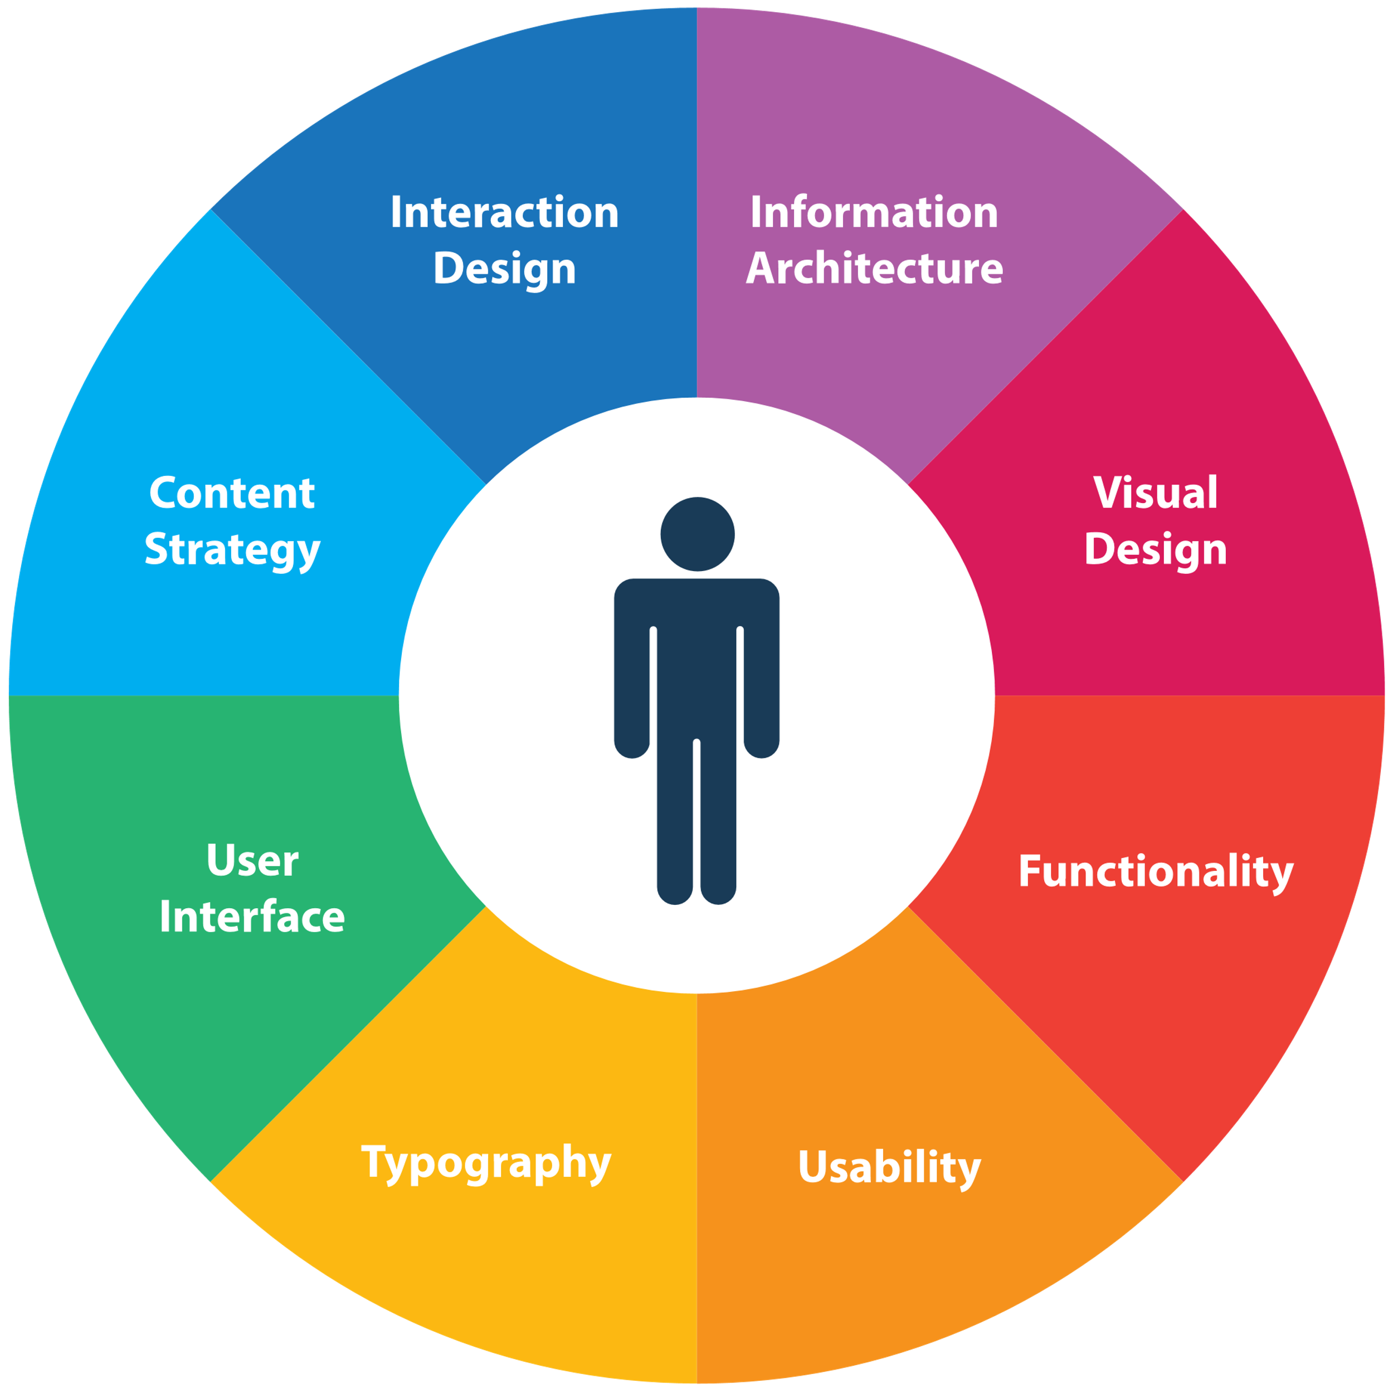
User-center design

Slide 6
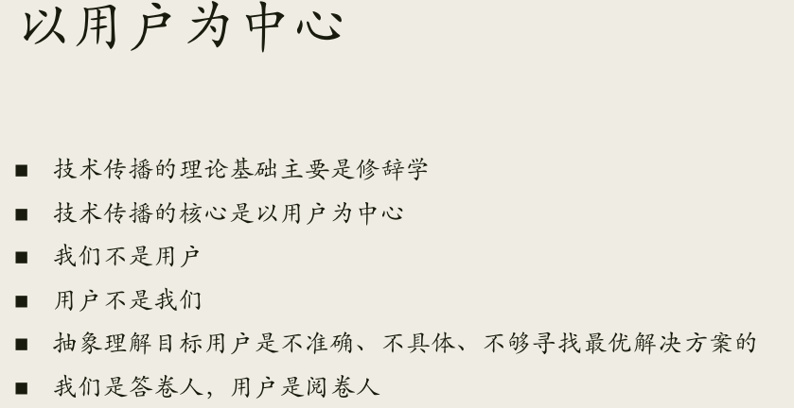

Slide 7
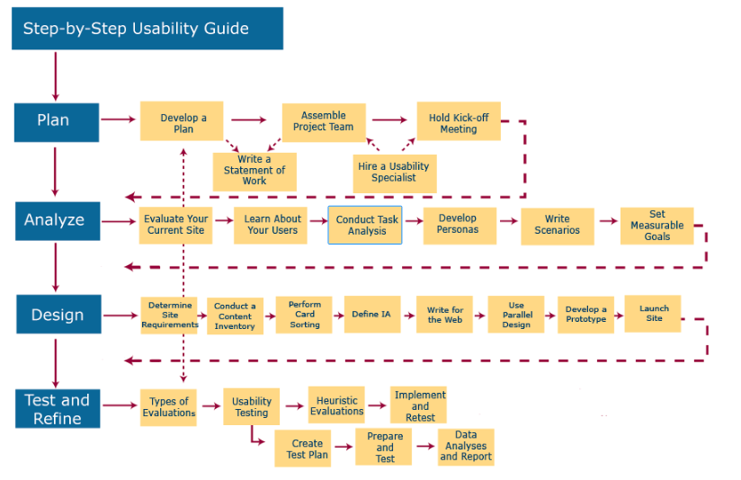
https://www.usability.gov/how-to-and-tools/resources/ucd-map.html

Slide 8
User-center design
User center design is a development method that guarantees your product, software or web site will be easy to use. The International Usability Standard, ISO 13407, specifies the principles and activities that underlie user center design:
The design is based upon an explicit understanding of users, tasks and environments.
Users are involved throughout design and development.
The design is driven and refined by user-center evaluation.
The process is iterative.
The design addresses the whole user experience.
The design team includes multidisciplinary skills and perspectives.

Slide 9
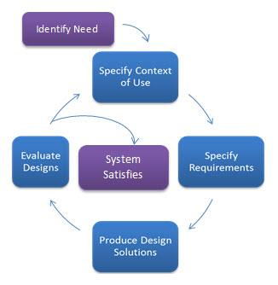
The following are the general phases of the UCD process:
Specify the context of use: Identify the people who will use the product, what they will use it for, and under what conditions they will use it.
Specify requirements: Identify any business requirements or user goals that must be met for the product to be successful.
Create design solutions: This part of the process may be done in stages, building from a rough concept to a complete design.
Evaluate designs: Evaluation - ideally through usability testing with actual users - is as integral as quality testing is to good software development.

Slide 10
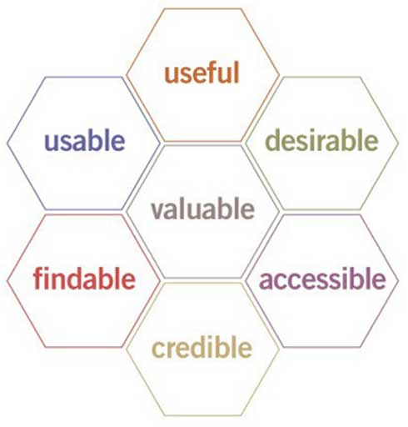
Factors that Influence UX
At the core of UX is ensuring that users find value in what you are providing to them. Peter Morville represents this through his User Experience Honeycomb.

Slide 11
Factors that Influence UX
Useful: Your content should be original and fulfill a need
Usable: Site must be easy to use
Desirable: Image, identity, brand, and other design elements are used to evoke emotion and appreciation
Findable: Content needs to be navigable and locatable onsite and offsite
Accessible: Content needs to be accessible to people with disabilities
Credible: Users must trust and believe what you tell them

Slide 12
User research
User research focuses on understanding user behaviors, needs, and motivations through observation techniques, task analysis, and other feedback methodologies.
https://www.usability.gov/what-and-why/user-research.html

Slide 13
User research ---Task Analysis
Task analysis is the process of learning about ordinary users by observing them in action to understand in detail how they perform their tasks and achieve their intended goals.
Tasks analysis helps identify the tasks that your website and applications must support and can also help you refine or re-define your site’s navigation or search by determining the appropriate content scope.

Slide 14
Purpose of Task Analysis
What your users’ goals are; what they are trying to achieve
What users actually do to achieve those goals
What experiences (personal, social, and cultural) users bring to the tasks
How users are influenced by their physical environment
How users’ previous knowledge and experience influence:
How they think about their work
The workflow they follow to perform their tasks

Slide 15
When to Perform a Task Analysis
It’s important to perform a task analysis early in your process, in particular prior to design work. Task analysis helps support several other aspects of the user-centered design process, including:
Website requirements gathering
Developing your content strategy and site structure
Wireframing and Prototyping
Performing usability testing

Slide 16
Types of Task Analysis
There are several types of task analysis but among the most common techniques used are:
Cognitive Task Analysis is focused on understanding tasks that require decision-making, problem-solving, memory, attention and judgement.
Hierarchical Task Analysis is focused on decomposing a high-level task subtasks.

Slide 17
How to Conduct a Task Analysis
Your task analysis may have several levels of inquiry, from general to very specific. In addition to market research, competitive analysis, and web metrics analysis, you can identify top tasks through various user research techniques.
UXPA’s Usability Body of Knowledge breaks down the process for decomposing a high-level task into the following steps:
Identify the task to be analyzed.
Break this high-level task down into 4 to 8 subtasks. The subtask should be specified in terms of objectives and, between them, should cover the whole area of interest.
Draw a layered task diagram of each subtasks ensuring that it is complete
Produce a written account as well as the decomposition diagram.
Present the analysis to someone else who has not been involved in the decomposition but who knows the tasks well enough to check for consistency

Slide 18
Task Analysis Practice
User: students who want to know more our university.
Goal: decide whether to apply or not?
Task:

Slide 19
Task Analysis Practice
User: parents?
Goal: decide whether to apply or not?
Task:

Slide 20
User research---persona
The creation of a representative user based on available data and user interviews. Though the personal details of the persona may be fiction, the information used to create the user type is not.

Slide 21
Persona
The purpose of personas is to create reliable and realistic representations of your key audience segments for reference. These representations should be based on qualitative and some quantitative user research and web analytics. Remember, your personas are only as good as the research behind them.
Effective personas:
Represent a major user group for your website
Express and focus on the major needs and expectations of the most important user groups
Give a clear picture of the user's expectations and how they're likely to use the site.
Aid in uncovering universal features and functionality
Describe real people with backgrounds, goals, and values

Slide 22


Slide 23
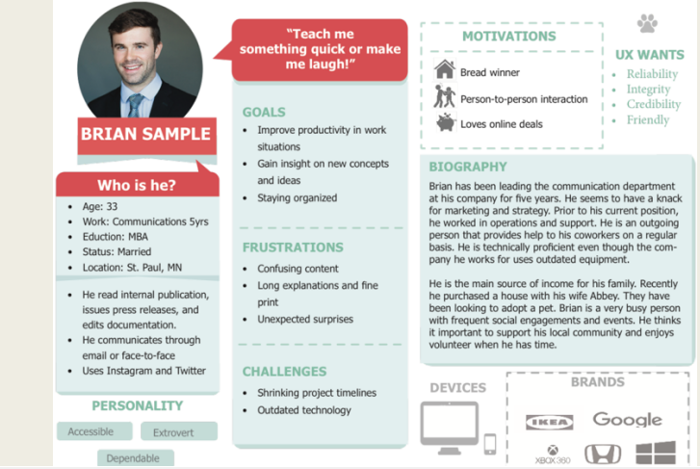

Slide 24
Benefits of Personas
Personas help to focus decisions surrounding site components by adding a layer of real-world consideration to the conversation. They also offer a quick and inexpensive way to test and prioritize those features throughout the development process. In addition they can help:
Stakeholders and leaders evaluate new site feature ideas
Information architects develop informed wireframes, interface behaviors, and labeling
Designers create the overall look and feel of the website
System engineers/developers decide which approaches to take based on user behaviors
Copy writers ensure site content is written to the appropriate audiences

Slide 25
Best Practices for Developing Personas
Personas development belongs at the beginning of the project, as personas can inform site functionality, help uncover gaps, or highlight new opportunities.
To ensure your personas are accurate representations of your users and have the support of your stakeholders throughout the process, you should:
Conduct user research: Answer the following questions: Who are your users and why are they using the system? What behaviors, assumptions, and expectations color their view of the system?
Condense the research: Look for themes/characteristics that are specific, relevant, and universal to the system and its users.
Brainstorm: Organize elements into persona groups that represent your target users. Name or classify each group.
Refine: Combine and prioritize the rough personas. Separate them into primary, secondary, and, if necessary, complementary categories. You should have roughly 3-5 personas and their identified characteristics.
Make them realistic: Develop the appropriate descriptions of each personas background, motivations, and expectations. Do not include a lot of personal information. Be relevant and serious; humor is not appropriate.

Slide 26
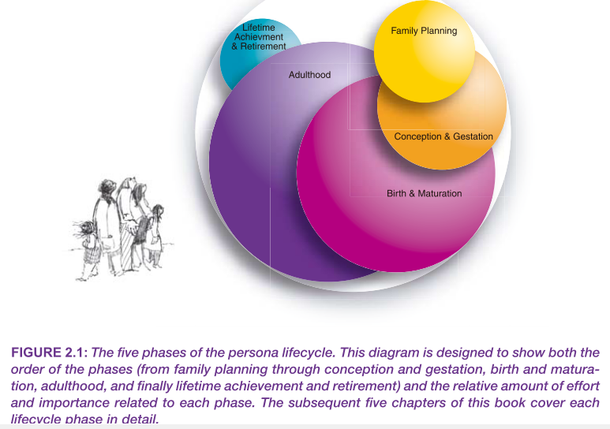

Slide 27
Phase 3: persona birth and maturation
Creating a persona campaign plan to organize your work in birth and maturation and adulthood.
Introducing the personas (and the persona method) to the product team
Ensuring that the personas are understood, revered, and likely to be used (for example,
creating artifacts to progressively disclose persona details)
Managing the minor changes to the persona descriptions that become necessary after the personas are introduced.
(The Persona Lifecycle by John Pruitt, Tamara Ad)

Slide 28
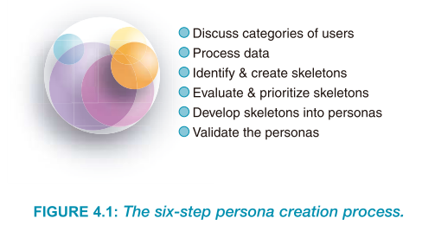

Slide 29
Elements in a persona(not all necessary)
● Identifying details
❍ Name, title, or short description
❍ Age, gender
❍ Identifying tag line
❍ Quote (highlighting something essential to that persona, preferably related to the product)
❍ Photograph or brief physical description
● Role(s) and tasks
❍ Specific company or industry
❍ Job title or role
❍ Typical activities
❍ Important atypical activities
❍ Challenge areas or breakdowns, pain points
❍ Responsibilities
❍ Interactions with other personas, systems, products

Slide 30
Elements in a persona(not all necessary)
● Goals
❍ Short term, long term
❍ Motivations
❍ Work-related goals
❍ Product-related goals
❍ General (life) goals, aspirations
❍ Stated and unstated desires for the product
● Segment
❍ Market size and influence
❍ International considerations
❍ Accessibility considerations
❍ General and domain-relevant demographics
■ Income and purchasing power
■ Region or city, state, country
■ Education level
■ Marital status
■ Cultural information

Slide 31
Elements in a persona(not all necessary)
● Skills and knowledge
❍ General computer and/or Internet use
❍ Frequently used products, product knowledge
❍ Years of experience
❍ Domain knowledge
❍ Training
❍ Special skills
❍ Competitor awareness
● Context/environment
❍ Equipment (Net connection, browser brand and version, operating system)
❍ “A day in the life” description
■ Work styles
■ Time line of a typical day
❍ Specific usage location(s)
❍ General work, household and leisure activities
❍ Relationships to other personas
● Psychographics and personal details
❍ Personality traits
❍ Values and attitudes (political opinions, religion)
❍ Fears and obstacles, pet peeves
❍ Personal artifacts (car, gadgets)

Slide 32
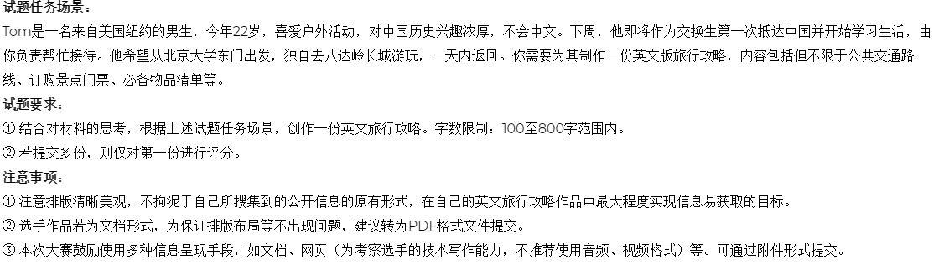
Practice for User Research---北大计算机辅助翻译大赛

Slide 33
The process of writing instructions
Analyze your audience
Who are your readers?
What do they already understand about the subject?
What is their attitude toward the subject?
What are their language skills?
Where and how will they be using the instruction manual?

Slide 34
The process of writing instructions
Analyze your audience and purpose
State your purpose
Gather and organize your information
Design the document
Draft the document
Revise, edit, and proofread the document
Test the document

Slide 35
The process of writing instructions
Analyze your audience
State your purpose
to explain the procedure to follow in case of chemical contamination in the lab

Slide 36
3. Gather and organize your information

Slide 37
The process of writing instructions
Design the document
Your design will depend on
the medium you choose (paper or online)
the amount of information you want to communicate
the reading ability of your readers
the conditions under which the document will be read, etc.

Slide 38
Designing the document
What are your reader’s expectations?
Do you need to create more than one set of instructions for different audiences?
Will the environment in which the instructions are read affect the document design?
Using instructions outdoors
Small, enclosed area
Should you make your pages multilingual?
Simultaneous or sequential
Simultaneous design
Multicolumn page
Sequential design
All information in English and then Spanish

Slide 39
Delivering Usable Information
A document usability is a measure of how well a document can fulfill the information that its audience needs, for example the user needs be able to:
easily locate the needed information
immediately understand the needed information
successfully use the information
Preparing usable information requires analyzing your audience and the ways they would use the document.

Slide 40
Planning for safety
American National Standard Institute (ANSI)
“A product safety sign or label should alert persons to a specific hazard, the degree or level of hazard seriousness, the probable consequence of involvement with the hazard, and how the hazard can be avoided.”

Slide 41
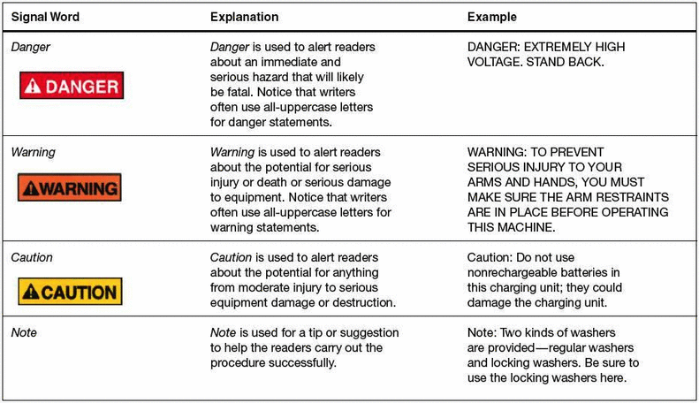

Planning for safety
Designing effective safety information

Slide 42
Planning for safety
Occupational Safety and Health Administration Guidelines’ standards for placing safety messages on products and manuals
Is the message prominently displayed so that users see it?
Is the message large enough and clearly legible under operating conditions?
Are the graphics and the words of the message clear and informative?

Slide 43
Planning for safety
Writing effective safety information
Be clear and concise
It is required that safety glasses be worn when inside this laboratory
You must wear safety glasses in this laboratory
Wear safety glasses in this laboratory

Slide 44
5. Drafting effective instructions
Most sets of instructions contain four elements
Title
General introduction
Step-by-step instructions
Conclusion

Slide 45
Title
Simple and clear
How-to
How to Install the J112 Shock Absorber
Gerund
Installing the J112 Shock Absorber

Slide 46
General introduction
Who should carry out the task?
Why should the reader carry out this task?
When should the reader carry out this task?
What safety measures or other concerns should the reader understand?
What items will the reader need?
How long will the task take?

Slide 47
Step-by-step instructions
Number the instructions
For long, complex instructions, use two-level numbering, such as a decimal system. 1 1.1 1.2 2 2.1 2.2 etc.
If you need to present a long set of steps, such as 50, group them logically into, say, six sets of eight or nine steps, and begin each set with a clear heading.

Slide 48
Step-by-step instructions
Subject
Goal
Safety information
Pre-condition
Action
Result
Reminder
example

Slide 49
Step-by-step instructions
Present the right amount of information in each step
Each step should define a single task the reader can carry out easily
1. Mix one part cement with one part water, using the trowel. When the mixture is a thick consistency without any lumps bigger than a marble, place a strip of the mixture about 1″ high and 1″ wide along the face of the brick.
2. Pick up the trowel.
Mix one part cement with one part water, using the trowel, until the mixture is a thick consistency without any lumps bigger than a marble.
2. Place a strip of the mixture about 1″ high and 1″ wide along the face of the brick.

Slide 50
Step-by-step instructions
Use the imperative mood
You should attach the red wire
Attach the red wire
The operator should attach the red wire
The red wire is attached

Slide 51
Step-by-step instructions
Do not confuse steps and feedback statements
Insert the disk in the drive
The system will now update your user information
Do not make a feedback statement a numbered step. Present it as part of the step to which it refers.

Slide 52
Step-by-step instructions
Graphics
Photographs, drawings, charts

Slide 53
Use markup

Slide 54
Designing the pages
Create an open, airy design
Clearly relate the graphics to the text

Slide 55
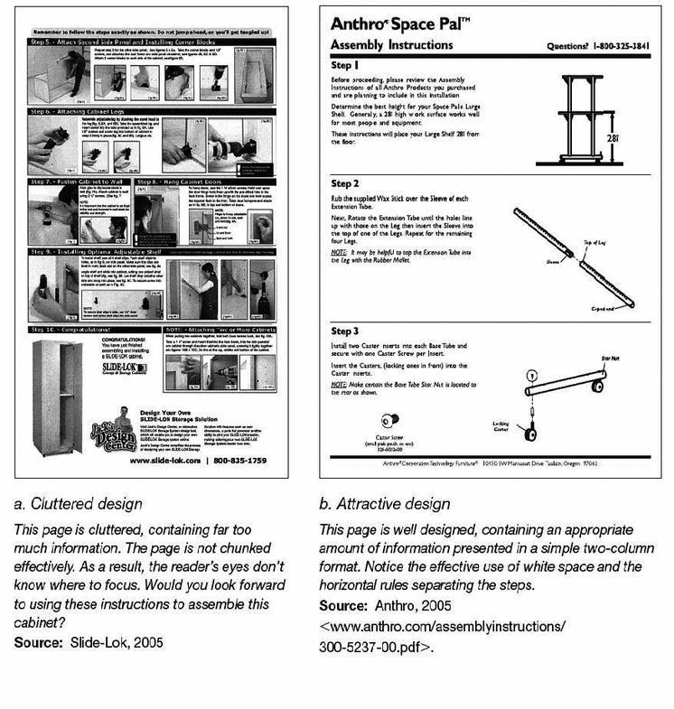

Slide 56
Conclusion
State that the reader has completed the task
Describe what the reader should do next
Maintenance tips or troubleshooting
Now that you have replaced the glass and applied the glazing compound, let it sit for at least five days so that the glazing can cure. Then prime and paint the window.

Slide 57
Instructions
Title
General introduction
Step-by-step instructions
Conclusion

Slide 58
The process of writing instructions
Draft, revise, edit, and proofread the document
In revising, check the document to see whether you can carry out the process it describes
User scenarios
Show it to subject-matter experts to see whether it contains any errors or omissions
Test the document

Slide 59
Cognitive Walkthrough
1) The user sets a goal to be accomplished with the system (for example, "check spelling of this document").
2) The user searches the interface for currently available actions (menu items, buttons, etc.).
3) The user selects the action that seems likely to make progress toward the goal.
4) The user performs the selected action and evaluates the system's feedback for evidence that progress is being made toward the current goal.

Slide 60
Cognitive Walkthrough
Will the user know what to do at this step?
If the user does the right thing, will they know that they did the right thing, and are making progress towards their goal?

Slide 61
The process of writing instructions
Analyze your audience and purpose
State your purpose
Gather and organize your information
Design the document
Draft the document
Revise, edit, and proofread the document
Test the document

Slide 62
Homework
Design a persona who want to pay a visit to one of Chinese scenic spot.
Design a travel guide to meet the very needs of this persona.
Deadline: 10.31 10p.m.
Showcase:11.5

Slide 63
Practice for TC---北大计算机辅助翻译大赛

Slide 64
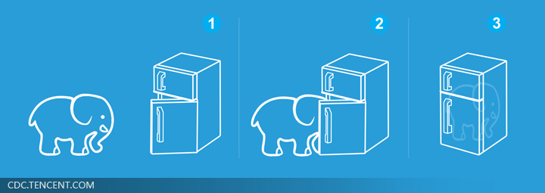
TW Practice---把大象放进冰箱说明书

Slide 65
http://cdc.tencent.com/2011/03/21/%E6%8B%96%E6%94%BE%E4%B8%89%E9%83%A8%E6%9B%B2%E2%80%94%E2%80%94%E4%BB%8E%E2%80%9C%E6%8A%8A%E5%A4%A7%E8%B1%A1%E6%94%BE%E8%BF%9B%E5%86%B0%E7%AE%B1%E2%80%9D%E8%AF%B4%E8%B5%B7/

